Slide 1
Memory

Slide 2

This is a Byte
1 | 0 | 1 | 1 | 0 | 0 | 1 | 1
This is a single Storage Unit
A Storage Unit stores a Byte

Slide 3
Solution:
Number Each Storage Unit Uniquely
A Question:
How to Identify Each Storage Unit Uniquely?
A memory is a collection of Storage Units.

Slide 4
A number which identifies each Storage Unit uniquely is known as Address.
1
2
3
4
5
6
7
8
A memory is a collection of Storage Units.

Slide 5
This is Address
3
This is Data
1 | 0 | 1 | 1 | 0 | 0 | 1 | 1
Storage Unit

Slide 6
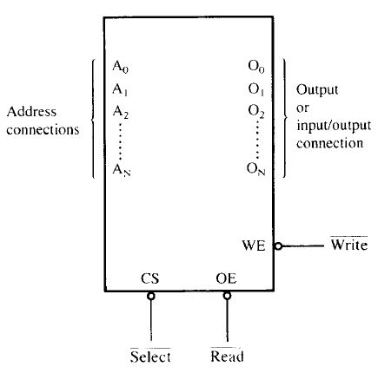
A pseudo memory component illustrating the address, data, and control connections.

